Slide 1
UNIT-4 Prepared by, Sree Sankar. J Assistant Professor CSE, KITS

Slide 2
Directive Principles of State Policy (DPSP)
The Directive Principles of State Policy are enumerated in Part IV of the Constitution from Articles 36 to 51.
The framers of the Constitution borrowed this idea from the Irish Constitution of 1937, which had copied it from the Spanish Constitution.
Dr. B.R. Ambedkar described these principles as ‘novel features’ of the Indian Constitution.

Slide 3
FEATURES OF THE DPSP
It denotes the ideals that the State should keep in mind while formulating policies and enacting laws.
The Directive Principles resemble the ‘Instrument of Instructions’
It promotes the concept of a ‘welfare state’ and not that of a ‘police state’
They are not legally enforceable by the courts.

Slide 4
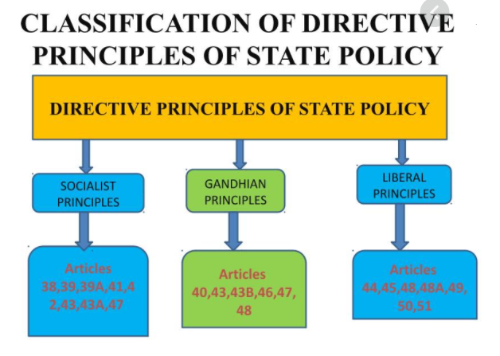
CLASSIFICATION OF THE DPSP
3 broad categories
1. Socialistic Principles
2. Gandhian Principles
3. Liberal-intellectual Principles

Slide 5
1. Socialistic Principles
These principles reflect the ideology of socialism.
Aims at providing social and economic justice
To promote the welfare of the people (Article 38)
To promote equal justice and to provide free legal aid to the poor (Art 39)
Equitable distribution of material resources of the community for the common good (Art 39)
Prevention of concentration of wealth (Art 39)
Equal pay for equal work for men and women (Art 39)
To secure a living wage, a decent standard of life (Art 43)
To secure the right to work, to education (Art 43)

Slide 6
2. Gandhian Principles
These principles are based on Gandhian ideology.
To organize village panchayats to function as units of self-government (Article 40)
To promote Village and cottage industries (Art 43)
To promote the educational and economic interests of SCs, STs, and other weaker sections of the society (Art 46)
To prohibit the consumption of intoxicating drinks and drugs which are injurious to health (Article 47)

Slide 7
3. Liberal-Intellectual Principles
This principles represent the ideology of liberalism.
Uniform Civil Code throughout the country (Article 44)
To provide early childhood care and education for all children until they complete the age of six years (Article 45)
To protect and improve the environment and to safeguard forests and wild life (Article 48 A)
To protect monuments, places and objects of artistic or historic interest (Article 49)
To promote international peace and security and maintain just and honorable relations between nations (Article 51)

Slide 8
NEW DPSP
The 42nd Amendment Act of 1976 added four new Directive Principles to the original list.
They require the State:
1. To secure opportunities for healthy development of children (Article 39).
2. To promote equal justice and to provide free legal aid to the poor (Article 39A).
3. To take steps to secure the participation of workers in the management of industries (Article 43 A).
4. To protect and improve the environment and to safeguard forests and wild life (Article 48 A).

Slide 9
Fundamental Duties
The original constitution contained only the fundamental rights and not the fundamental duties.
Later in 1976, the fundamental duties of citizens were added in the Constitution. In 2002, one more Fundamental Duty was added.
The Fundamental Duties in the Indian Constitution are inspired by the Constitution of USSR.

Slide 10
LIST OF FUNDAMENTAL DUTIES
According to Article 51A, it shall be the duty of every citizen of India:
1. To abide by the Constitution and respect its ideals and institutions, the National Flag and the National Anthem.
2. To cherish and follow the noble ideals that inspired them national struggle for freedom.
3. To uphold and protect the sovereignty, unity and integrity of India.
4. To defend the country and render national service when called upon to do so.
5. To promote harmony and the spirit of common brotherhood amongst all the people of India.

Slide 11
6. To value and preserve the rich heritage of the country’s composite culture.
7. To protect and improve the natural environment including forests, lakes, rivers and wildlife.
8. To develop scientific temper, humanism and the spirit of inquiry and reform.
9. To safeguard public property and to abjure violence.
10.To strive towards excellence in all spheres of individual and collective activity so that the nation constantly rises to higher levels of endeavor and achievement.
11.To provide opportunities for education to his child or, ward between the age of 6 - 14 years. This duty was added by the 86th Constitutional Amendment Act, 2002.

Slide 12
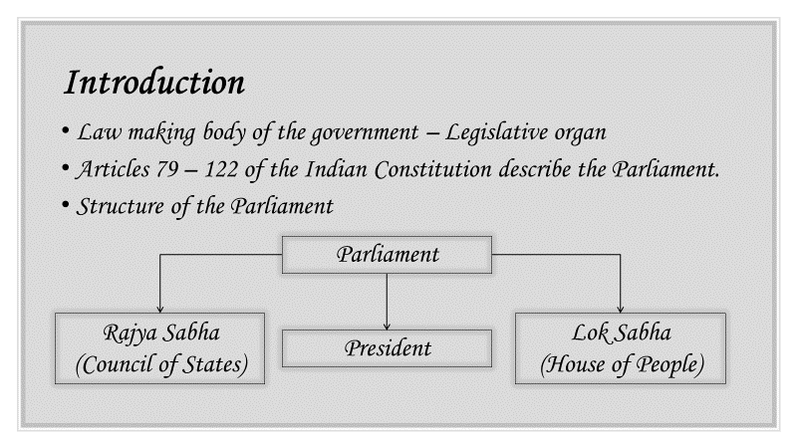
Organs of Governance: Parliament
Law making body of the government – Legislative organ the Union government.
The Parliament is the legislative organ of Articles 79 to 122 in Part V of the Constitution deal with the organization, composition, duration, officers, procedures, privileges, powers of the Parliament

Slide 13
ORGANISATION/COMPOSTION OF PARLIAMENT
Under the Constitution, the Parliament of India consists of three parts: the President, the Council of States(‘Rajya Sabha’) and the House of the People (‘Lok Sabha’)
The Rajya Sabha is the Upper House (Second Chamber or House of Elders) and the Lok Sabha is the Lower House (First Chamber or Popular House).
Though the President of India is not a member of either House of Parliament, he is an integral part of the Parliament. This is because a bill passed by both the Houses of Parliament cannot become law without the President’s assent.

Slide 14
The President
• The President is the head of the Indian State.
• He is the first citizen of India and acts as the symbol of unity, integrity and solidarity of the nation.
ELECTION OF THE PRESIDENT
The President is elected not directly by the people but by members of electoral college consisting of:
1. The elected members of both the Houses of Parliament.
2. The elected members of the legislative assemblies of the states.
3. The elected members of the legislative assemblies of the Union Territories of Delhi and Puducherry.
Veto power: A bill passed by the Parliament can become an act only if it receives the assent of the President.

Slide 15
Qualifications for Election as President of India
A person to be eligible for election as President should fulfill the following qualifications:
1. He should be a citizen of India.
2. He should have completed 35 years of age.
3. He should be qualified for election as a member of the Lok Sabha.
4. He should not hold any office of profit under the Union government or any state government or any local authority or any other public authority.

Slide 16
Term of President’s Office
The President holds office for a term of five years
He can resign from his office at any time by addressing the resignation letter to the Vice President.
Further, he can also be removed from the office before completion of his term by the process of impeachment.
Impeachment of President
The President can be removed from office by a process of impeachment.
The impeachment charges can be initiated by either House of Parliament.
These charges should be signed by one-fourth members of the House and a 14 days’ notice should be given to the President.
After the impeachment resolution is passed by a majority of two thirds of the total membership of both Houses, then the President stands removed from his office from the date on which the resolution is so passed.

Slide 17
POWERS AND FUNCTIONS OF THE PRESIDENT
1. Executive powers: He appoints the prime minister and the other ministers, attorney general of India, the chief election commissioner, administers the union territories.
2. Legislative powers: He can summon the Parliament and dissolve the Lok Sabha and can hold Joint sessions of both houses. He nominates 12 members of the Rajya Sabha (Various fields) and nominate two members to the Lok Sabha from the Anglo-Indian Community
3. Financial powers: He constitutes a finance commission after every five years and make advances out of the contingency fund
4. Judicial powers: He appoints the Chief Justice and the judges of Supreme Court and high courts.
5. Diplomatic powers: He represents India in international forums and affairs and sends and receives diplomats like ambassadors, high commissioners, and so on.
6. Military powers: He is the supreme commander of the defense forces of India. In that capacity, he appoints the chiefs of the Army, the Navy and the Air Force.
7. Emergency powers: (a) National Emergency (Article 352); (b) President’s Rule (Article 356 & 365); and (c) Financial Emergency (Article 360)

Slide 18
Rajya Sabha (Upper House)
• The maximum strength of the Rajya Sabha(Fourth Schedule of the Constitution) is fixed at 250, out of which, 238 are to be the representatives of the states and union territories (elected indirectly) and 12 are nominated by the president.
1. Representation of States: The representatives of states in the Rajya Sabha are elected by the elected members of state legislative assemblies. The seats are allotted to the states in the Rajya Sabha on the basis of population.

Slide 19
Rajya Sabha (Upper House)
2. Representation of Union Territories: The representatives of each union territory in the Rajya Sabha are indirectly elected by members of an electoral college specially constituted for the purpose.
3. Nominated Members: The president nominates 12 members to the Rajya Sabha from people who have special knowledge or practical experience in art, literature, science and social service.
The tenure of upper house is 6 years.
The Rajya Sabha (first constituted in 1952) is a continuing and permanent body and not subject to dissolution.

Slide 20
Lok Sabha (Lower House)
• The maximum strength of the Lok Sabha is fixed at 552. Out of this, 530 members are to be the representatives of the states, 20 members are to be the representatives of the union territories and 2 members are to be nominated by the president from the Anglo-Indian community.
• Its normal term is five years from the date of its first meeting after the general elections

Slide 21
Lok Sabha (Lower House)
1. Representation of States: The representatives of states in the Lok Sabha are directly elected by the people from the territorial constituencies in the states. (Universal Adult Franchise)
2. Representation of Union Territories: The Constitution has empowered the Parliament to choose the representatives of the union territories in the Lok Sabha.
3. Nominated Members: The president can nominate two members from the Anglo-Indian community.

Slide 22
MEMBERSHIP OF PARLIAMENT(Rajya Sabha & Lok Sabha) Qualifications and Disqualifications
Qualifications
The Constitution lays down the following qualifications for a person to be chosen a member of the Parliament (MP)
He must be a citizen of India.
He must be not less than 30 years of age in the case of the Rajya Sabha and not less than 25 years of age in the case of the Lok Sabha.
He must be a member of a scheduled caste or scheduled tribe in any state or union territory, if he wants to contest a seat reserved for them.

Slide 23
MEMBERSHIP OF PARLIAMENT(Rajya Sabha & Lok Sabha) Qualifications and Disqualifications
Disqualifications
Under the Constitution, a person shall be disqualified for being elected as a member of Parliament:
If he is of unsound mind and stands so declared by a court.
If he is not a citizen of India or has voluntarily acquired the citizenship of a foreign state
If he is so disqualified under any law made by Parliament.
He must not have been found guilty of certain election offences or corrupt practices in the elections.
He must not have been convicted for any offence resulting in imprisonment for two or more years.
He must not have been dismissed from government service for corruption or disloyalty to the State etc.,

Slide 24
Note: Facts
There is a Speaker and a Deputy Speaker for the Lok Sabha and a Chairman and a Deputy Chairman for the Rajya Sabha.
The Speaker and Deputy Speaker is elected by the Lok Sabha from amongst its members
The presiding officer of the Rajya Sabha is known as the Chairman. The vice-president of India is the ex-officio Chairman of the Rajya Sabha
The Deputy Chairman is elected by the Rajya Sabha itself from amongst its members

Slide 25
Powers and Functions of the Parliament
Legislative function
Basic function – to make laws
Amend old laws, make new laws, repeal old laws
Formation of the Cabinet
Form cabinet by leader of the majority party
Cabinet looks after day-to-day administration and decides policies of the government.

Slide 26
Control of Cabinet
Council of ministers, collectively and individually, responsible to the Parliament
Parliament enforces responsibility through questions, resolutions, adjournment motions, budgetary discussion, vote of no confidence etc.
Question Hour, the first hour of every working day
By raising questions, the members of parliament can focus public attention on the policies and activities of the government.
Debates on Adjournment Motions utilized for raising a discussion on questions of urgent nature and public importance.
Any minister can be questioned by a member of the Parliament.
Cabinet has to resign if no confidence motion is passed.
It ensures accountability of the executive in the parliamentary system.

Slide 27
Financial Powers
Parliament has the power to levy new tax.
The finance Minister submits the Annual Budget before the Lok Sabha. The parliament discusses it in detail and approves it.
Money Bills are introduced only in the Lok Sabha and requires sanction only of the Lok Sabha.
Judicial Powers
The Parliament can remove the President, Chief Election commissioner, the judges of the high court and Supreme Court by impeachment.
The parliament has the power to punish any one for breach of its privileges or for its contempt.

Slide 28
Power of amending the constitution
Approval of both the Houses is essential for amendment.
Amendment cannot change basic framework of the constitution.
Electoral Functions
Elects President and Vice President
Venting of grievances
Vents the grievances of the people through various parliamentary measures.

